Slide 1
Save the water
Sylwia zajda

Slide 2
Ecology
Ecology is the branch of biology that deals with the relations between organisms and their physical surroundings. Ecology is also about actions that repair or prevent damage to physical environment or natural resources
Prevent-zapobiagać
Natural resources- zasoby naturalne
Surroundings-otoczenie
Branch-dział

Slide 3
Water on earth
Water covers almost 71% of the earth. 96% of the water is in the oceans. Fresh water is only a few percent off all the water on earth. Fresh water is the only water that we can use in a daily life.

Slide 4
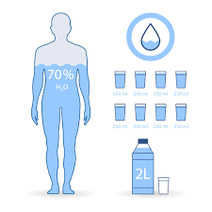
Water and human
Human body is roughly 60% water. Water is one of the most important substances in human life. We use water for ordinary things in our live for example: taking care of hygiene, cleaning out houses etc.

Slide 5
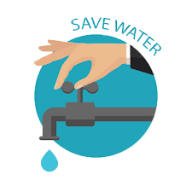
Why we have to save water?
Conserving water is really good for the environment and people. Drinking water resources are kept to a minimum, scientiests say that in 2050 there will not be enough water for people to live. We have to take care of that so it doesn’t happen.
Resources- zasoby

Slide 6
How to save water?
Take shorter showers to use less water.
Turn off the water while your bruching your teeth.
Use your dishowsher/washing machine only when it’s full.

Slide 7
Facts about saving water
turning off the tap while brushing your teeth saves 900 liters of water per month.
If the tap is leaking, we lose almost 12,000 liters of water a year.
According to the data, a statistical Pole consumes about 200-300 liters of water per day, and in Mozambique, there is 10 liters of water per one inhabitant.
Inhabitant-mieszkaniec

Slide 8
Thanks you for your attention

