Slide 1
Water pollution – unfavorable changes in water properties. Water pollution is mainly caused by chemicals, bacteria, present in natural waters in increased quantity. Other sources of water pollution are water and land transport, the use of pesticides and fertilizers. Waters are also polluted by humans – deforestation, inappropriate and excessive farming practices. ​ ​ ​

Slide 2
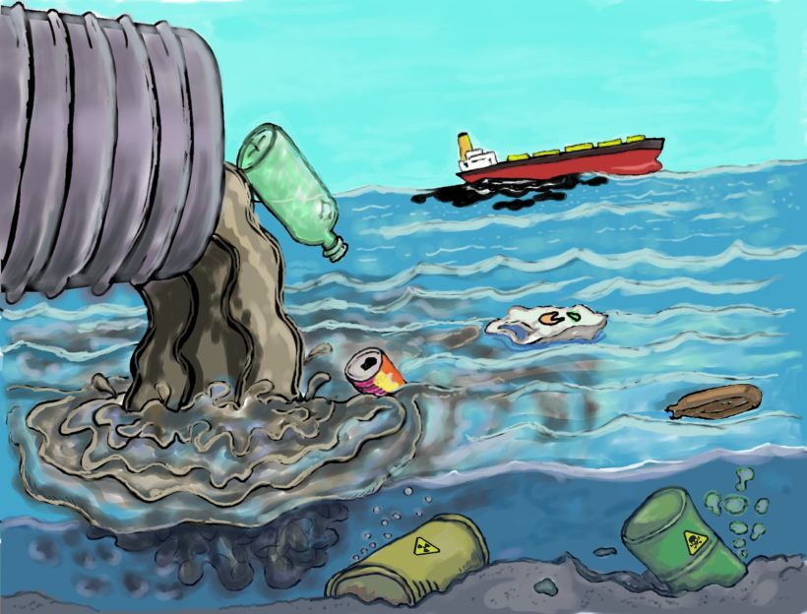
There are several types of water pollution, incl. Due tothe origin, degree of harmfulness, source or durability. ​ ​Breakdown of water pollutants according to their origin:​ - natural pollutnts, ​ - artificial pollution [caused by human activity] ​ Breakdown by degree of durability: - decomposable pollutants,​ - non-degradable pollution, ​ - persistent pollution,​ ​

Slide 3
Diseases, medical problems​ Water pollutants can cause disease or act as poisons. Bacteria and parasites in poorly treated wastewater can find their way into drinking water and cause digestive problems such as cholera and diarrhea. Hazardous chemicals, pesticides from industries, farms, and homes can cause acute toxicity and immediate death, or chronic toxicity that can lead to neurological problems or cancer.​

Slide 4
The most polluted rivers in the world
1. Matanza, Argentina​ The River Matanza is 64 kilometers long and is located in Riachuelo. Local residents often refer to it as the „Slaughterhouse River” indicating a high degree of pollution.​ Huge amounts of sewage and waste from slaughterhouses and tanneries flow into the Matanza River, polluting it with chemicals and heavy metals such as arsenic, chromium, mercury and copper. What is worse, domestic sewage directly flows into it As a result, Motanza is known for its foul smell, lack of life in it and has been on the list of the most polluted rivers since 2013.

Slide 6
2. Buriganga River, Bangladesh​ The Buriganga River is undoubtedly the dirtiest river in Bangladesh. 4 500 tons of pollutants reach it daily from the Bangladeshi capital, Dhaka.​ ​Almost any type of waste can be found in the Buriganga River, ranging from chemical waste from industrial plants, household and medical waste, to the bodies of dead animals. 80% of the wastewater discharged into the Buriganga River is not subject to treatment processes.​ As in the Matanza River, there is no point in looking for life forms in Buriganga.​

Slide 8
3. Marilao River, Philippines The Marilao River is polluted mainly by plants producing fur and textiles, as well as waste and municipal sewage. Greenpeace works to improve the quality of rivers in the Philippines. Their goal is to increase the authorities’ attention to the problem of water quality in rivers and the government aid program for the construction of sewage treatment plants.

Slide 9
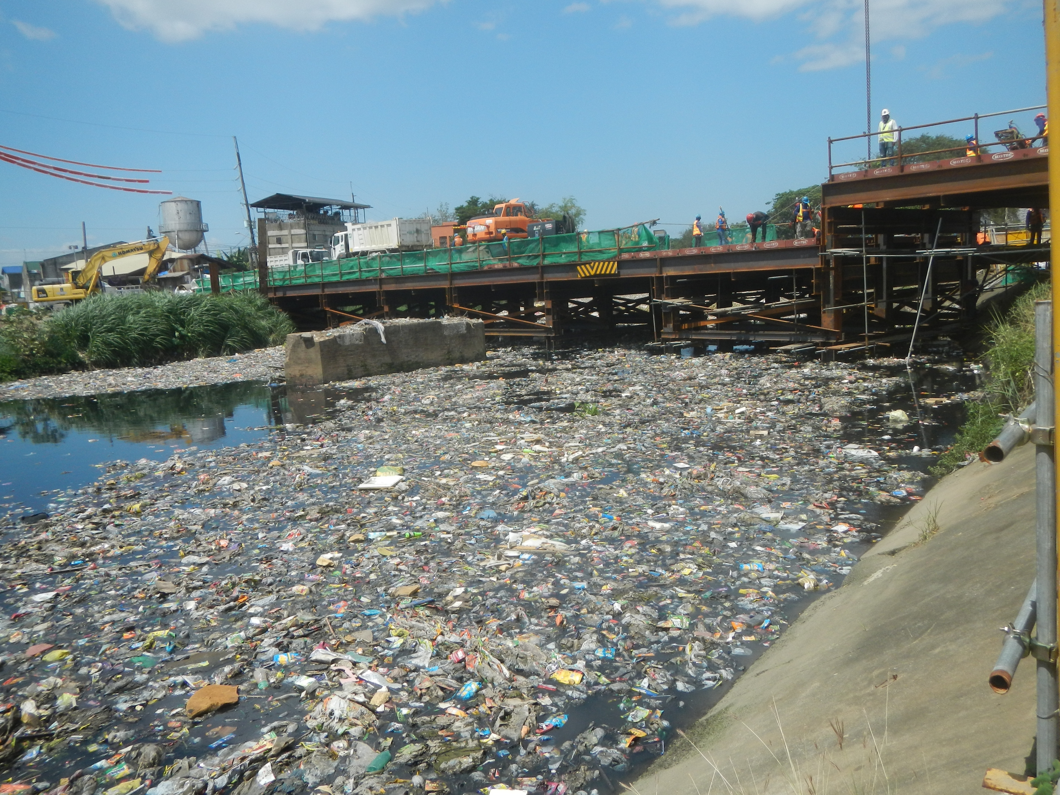

Slide 10
4. Sarno River, Italy​ This river is not only considered the most polluted in Europe, but also one of the most polluted in the world.​ It is contaminated with toxins from agriculture, industrial activity and households. The upstream appears clean, but downstream, oil stains and chemical foam can be seen.​ ​

Slide 12
5. Mississippi, USA The United States of America is also involved in the global riverside pollution. The Mississippi, one of the largest rivers in the world, is surrounded by vast and fertile agricultural areas. For this reason, most of the pollutants are of a typical agricultural nature, derived from the elements nitrogen and phosphorus.

Slide 14
6. Citarum River, Indonesia millions of inhabitants have made it their garbage can, even though they use it as a source of drinking water and for catching fish. However, the main culprits are not ordinary inhabitants, but industrial plants that discharge huge amounts of bad or not treated sewage into the river. This practice contributed to the fact that the Citarum River is considered one of the most polluted in the world. The waste shown in the photo below is proof enough.

Slide 16
7. Yellow River, China The nickname „Yellow” is not accidental. It proves the typical color of the river, which comes from the color of the transferred soil. Currently, the river takes on different colors due to the increasing level of industrialization in the region. The river has become a basket for toxic waste and therefore its waters cannot even be used for agriculture. 4 billion cubic meters of untreated sewage end up in the river each year.

Slide 18
8. Ganges, India It is one of the most polluted rivers in the world. The lack of a sewage treatment plant in 25 cities along its course results in extremely high pollution (600 km of the total length of 2,525 are considered highly polluted). Many Hindus consider her water to be a health elixir, and therefore they take a bath in it, drink it or even use it for cooking. It is all the more shocking as they are aware that the poorer inhabitants who cannot afford cremation are burying their deceased family members in it.

Slide 20
About 70% of our planet’s surface is covered by seas and oceans, and waste in the marine environment can be found almost everywhere. Waste, in particular plastic, is a threat not only to seas and coasts, but also to the economy and society. Most of the litter in the marine environment is generated on land.
Every year, about 10 million tons of rubbish ends up in the world’s seas and oceans. Plastics, in particular packaging such as drink bottles and disposable bags, make up the vast majority of them. However, the list goes on and on and includes damaged fishing nets, ropes, etc.
Unlike natural materials, plastics never „disappear” but accumulate in the environment, especially in the oceans and seas. Sun, salt water and waves break plastic debris into ever smaller pieces. It can take up to 500 years before a disposable diaper or plastic the bottle will decompose into microplastics, but not all microplastics are produced as a result of this disintegration process Products such as toothpaste, cosmetics and personal care products contain microplastics.

Slide 21
It is difficult to assess all the effects of waste in the waters of the seas and oceans. There are two main negative effects on marine fauna and flora: the entry of particles into the gastrointestinal tract and the entanglement of floating traps by debris.
Given the size and distribution of the waste, sea animals and birds confuse garbage with food. It is estimated that this waste entered the digestive tract of over 40% of whale, dolphin and porpoise species, all sea turtle species and about 36% of sea bird species. Consumption is not limited to one or two individuals – entire schools of fish and flocks of seabirds are affected. For example, more than 90% of Fulmarians found dead along the North Sea coast had plastic in their stomachs. What’s more, some species of fish that swallow plastic debris floating in the water end up on our plates. In this way, we are putting our health at risk by consuming seafood that has been in contact with plastics and petroleum-based chemicals.

Slide 22
What we can do to improve water quality?
STEP 1: REUSABLE BAGS One plastic bag can cause great harm to many sea creatures. Next time you go shopping, bring your own reusable bag. STEP 2: END WITH BALLOONS balloons are extremely dangerous to the life of the oceans. Any balloon that escapes our hands can end up in our waters. However, there is an alternative: choose a piñata instead. STEP 3: PACKING IN REVERSE Single-use packaging is very common in the food industry. Fortunately, you can now buy products that are not wrapped in plastic – from all kinds of baked goods to soap. Shop at bazaars or organic stores. If you are shopping at a supermarket, choose products in packaging that can be recycled. STEP 4: NUTRITION AWARENESS Very tiny plastic microparticles easily find their way into the digestive systems of sea creatures. It is worth considering twice, reaching for a plastic product again. STEP 5: REPEATABLE WATER BOTTLES 91% of plastic worldwide is not recycled. In addition, it is estimated that by 2021 the consumption of disposable bottles will increase to half a trillion. You just have to put them down as soon as possible. However, you can use aluminum or glass bottles, or plastic, but reusable.

