Slide 1
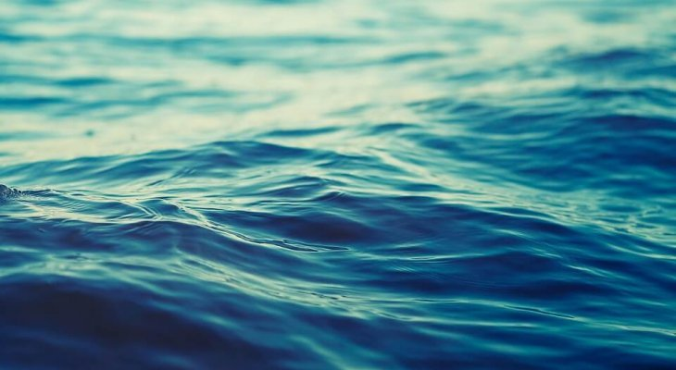
Everything about water
Filip tempiński kl.viiia

Slide 2
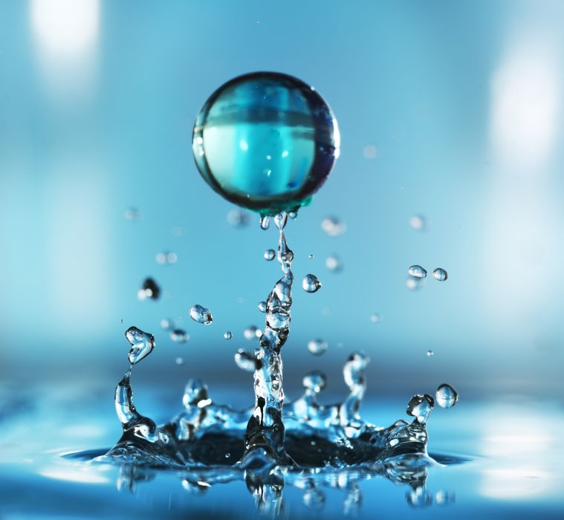
What we need to know about water
Water is a chemical compound .
It’s one of the factors that make life on Earth possible .
Water covers ¾ of our planet’s surface .
Dictionary :
Compound – związek
Factor – czynnik/element
Cover – zajmuje
Surface – przestrzeń

Slide 3
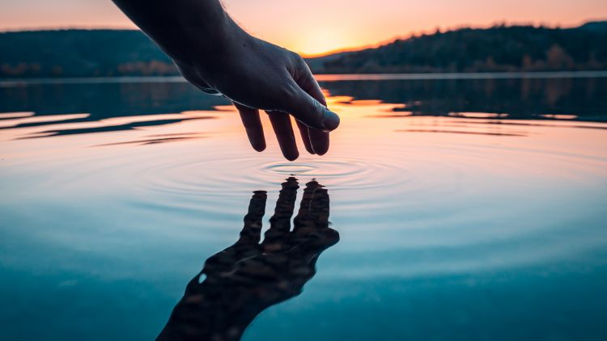
Why is water important ?
Water carries nutrients to all cells of our body and oxygen to the brain .
Waters helps regulate body temperature .
It allows the body to absorb and assimilate minerals and vitamins .
Dictionary :
Nutrients – składniki odżywcze
Oxygen – tlen
Absorb – wchłaniać
Assimilate - wchłonąć

Slide 4
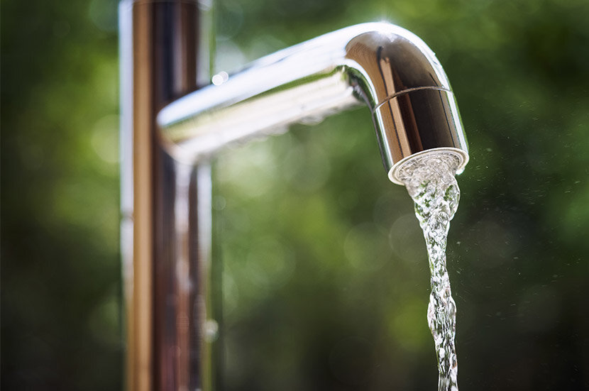
How to save water ?
Turn off the water while you are brushing teeth .
Don’t open the tap fully while you are washing hands .
Take a quick shower instead of a bath .
Dictionary :
Instead – zamiast
Fully – całkowicie
Tap - kran

Slide 5
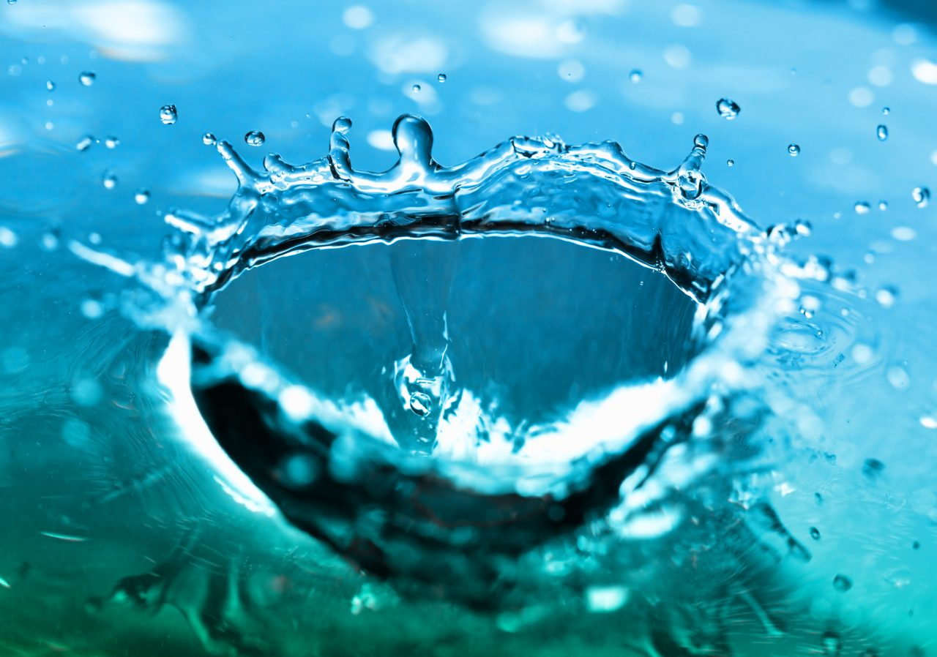
The effects of wasting water
When there isn’t enough water in our body , it becomes to dehydrated .
Burning forests with a reason to drought .
Animal extinction
Dictionary :
Dehydrated – odwodnienie
Drought – susza
Extinction – wymarcie

Slide 6
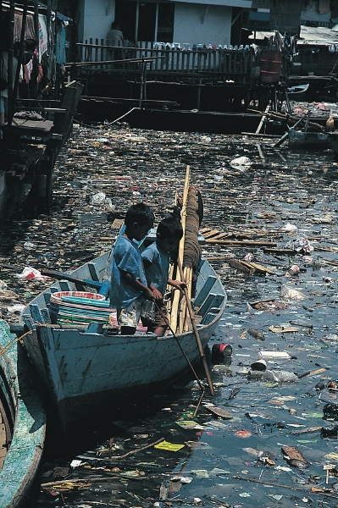
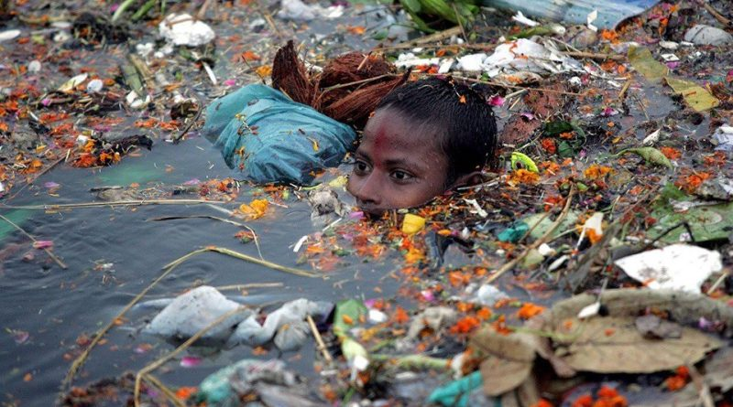
Water pollution
Water pollution – adverse changes in physical , chemical and bacteriological properties of water , that restrict or prevent the use of drinking water .
Dictionary :
Adverse – niekorzystne
Properties – właściwości
Restrict – ograniczają
Prevent – uniemożliwiają

Slide 7
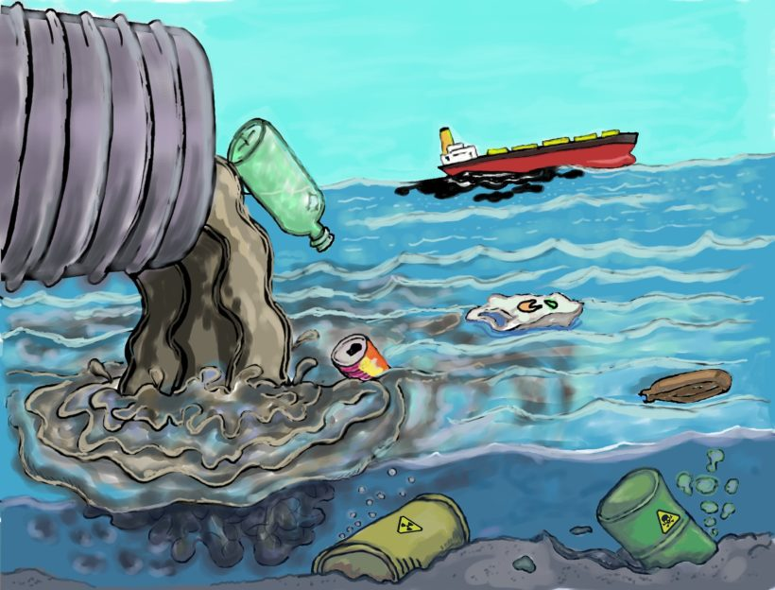
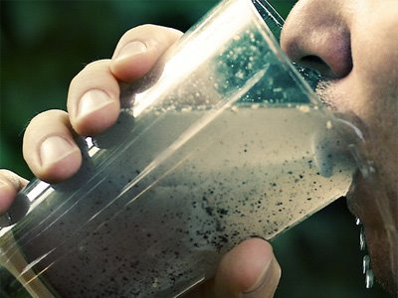
Effects of water pollution
Dying off of many aquatic organisms .
Development of harmful microorganisms .
Ills most often associated with the digestive system .
Dicionary :
Dying off – umieranie
Harmful – szkodliwy
Ills – choroby
Associated – powiązane
Digestive system – układ pokarmowy

Slide 8
Thank you for your attention

